Slide 1








Telangana Growth Analysis
Analysis
Insights and Suggestions
Stamp Registration
Transportation
Ts - Ipass

Slide 2
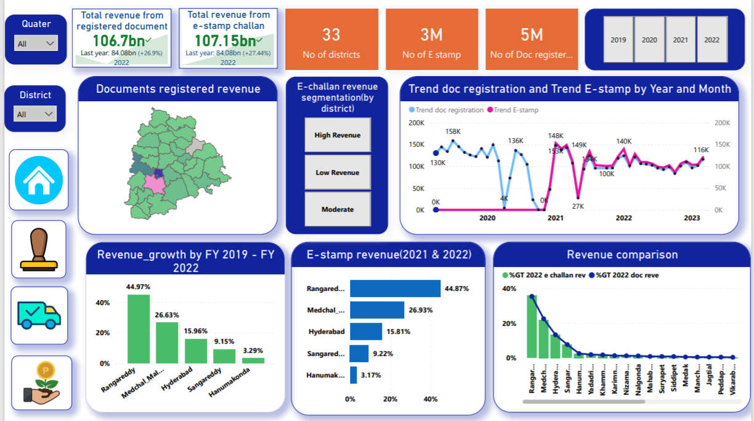

Slide 3
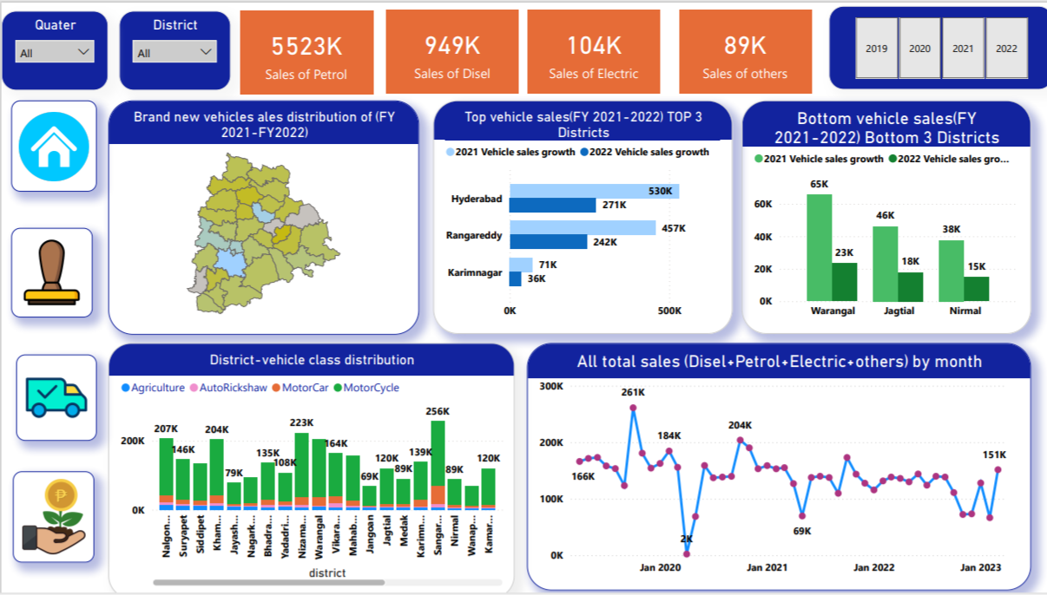

Slide 4
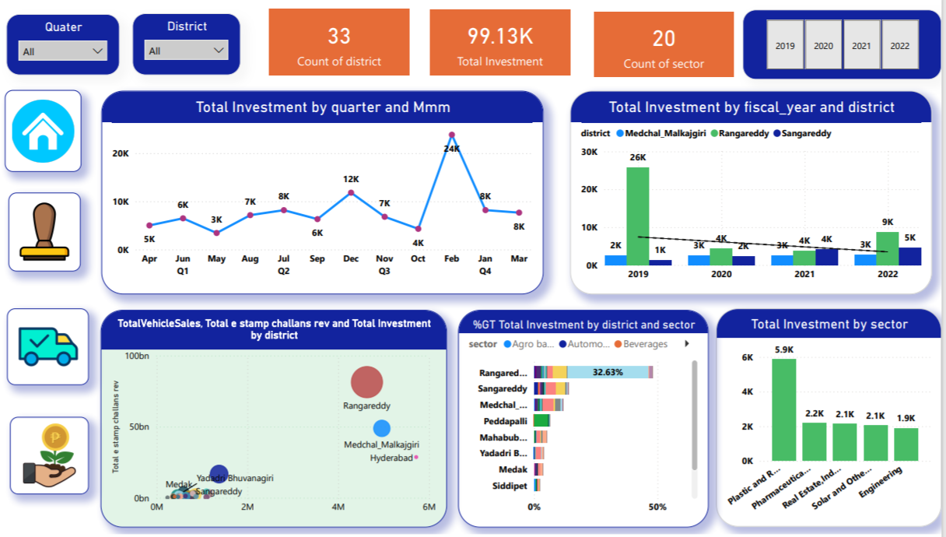

Slide 5
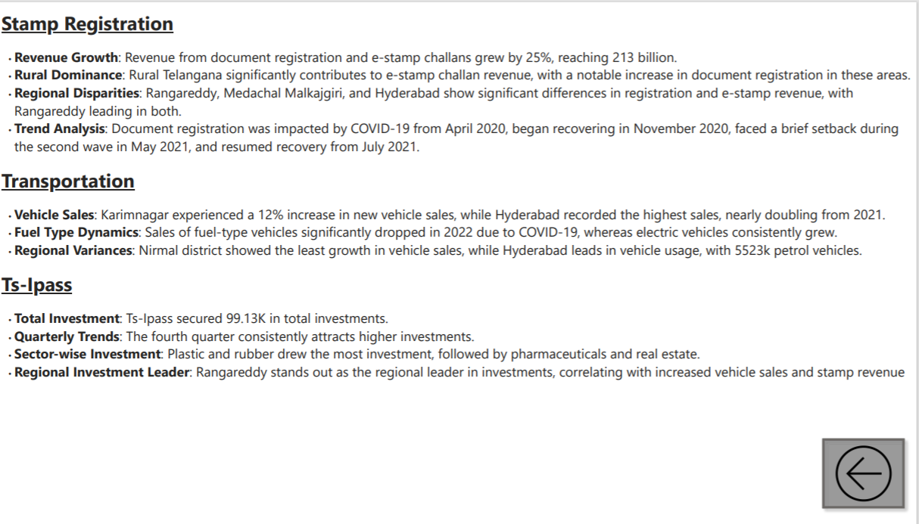

Slide 6
